Slide 1
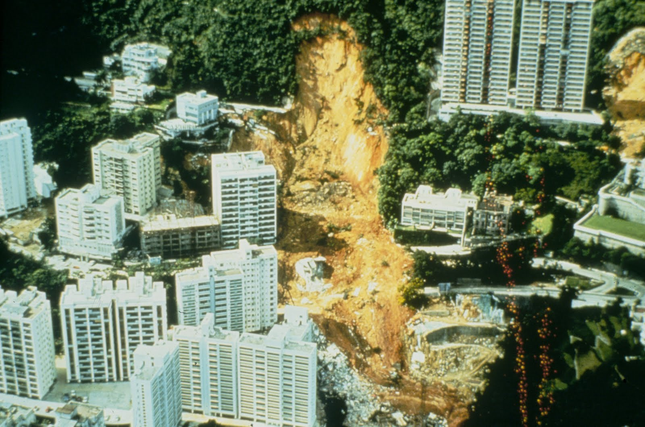

Slide 2
Landslide Database
Balancing
Feature Engineering
Model Training
Model Selection
Prediction

Slide 3
landslide prediction system in affected areas

Slide 4


Slide 5
Feasability and usability
Easy interface to query and train ML-algorithm
WebAPP?
Weighing predictions?
Percentage?

Slide 6
Potential in harnessing technology
Using drones for terrain image recognition? Prof. Ryley Beddoe

